Slide 1
Data Lab Interest Group
Michael Tang
24th Oct 2017

Slide 2
Focus
Data Visualization
Data Analytics
Data Mining
Distributed System Design
Big Data (Hadoop , Spark, NoSQL , Flume…)
Automation Operations

Slide 3
Benefits
Visualization Technology can be used for Admin Site Monitor
Hadoop/NoSQL will speed up DE support for Big Data platforms
Data Analytics/Mining is prepared as a subsequent potential value-added service for DE
Trend 2.0/3.0/4.0 will integrate with all the project data and provide Data Visualization, Risk Assessment, Intelligent Warning/Dispatch/Suggestion
Distributed System Architecture and Automated Operations provide technical accumulation for the possible architecture evolution of DE

Slide 4
Skills
Python
Linux
H5, Bootstrap, Asp.NET MVC/Web API, Vue/Angular JS
Restful API
Cluster
Hadoop, HBase, Hive, Sqoop, Pig
Spark, Redis, MongoDB, Kafka, Flume
Azure

Slide 5
Release 2.0
Duration: 01/10/2018 - 02/20/2018
Single Data Service
UI Improvement(Using Vue/Angular JS)
Redis/MongoDB as storage/cache
Data Mining/Machine Learning(Log, behavior)

Slide 6
Release 3.0
Duration: 02/20/2018 - 04/20/2018
Data Service HA(Cluster)
Mobile Terminal Display(H5)
Bugzilla/Tracker Support
Data Pre-Processing/Shuffle
Using Kafka for Decoupling data collector/data service

Slide 7
Release 4.0
Duration: 04/25/2018 - 07/25/2018
Map Reduce for offline Data Processing
Spark For Streaming Data Processing

Slide 8




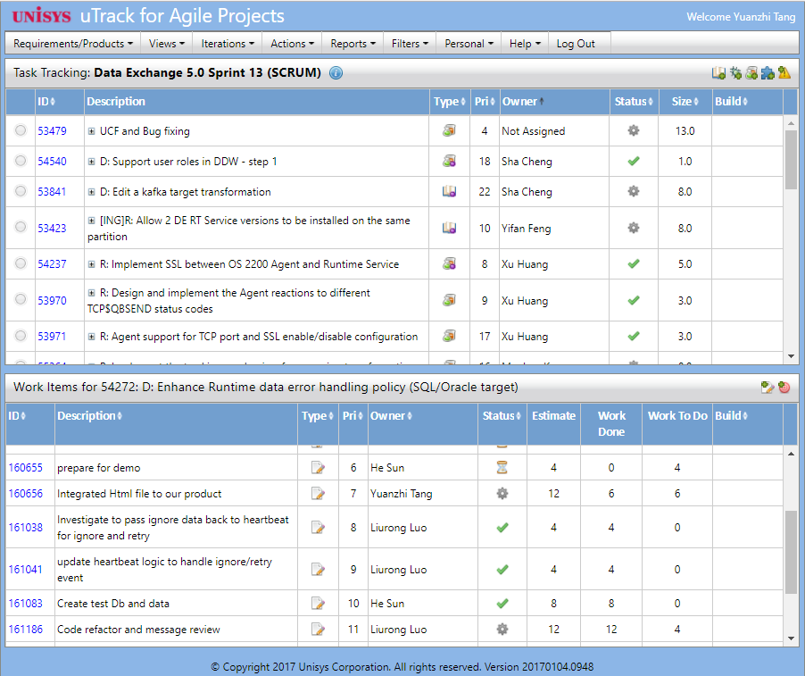
Trend 1.0 Architecture
Web Site
Statistics
Diagram Generator
Data Analyzer
Windows Disk
Data.json
Data_Last.json
CurrentSprintActivityData.json
Data Collector
Web Spider
Activity Analyzer
uTrack

Slide 9
Trend 2.0 Architecture
Web Site
Data Service
Statistics
Diagram Generator
Data Analyzer
Data Mining/ML
Data Center
Redis
MongoDB
Data Collector
Web Spider
Activity Analyzer
uTrack
Notes:
Develop Single Data Service
UI Improvement(Using Vue/Angular JS)
Using Redis/MongoDB as storage/cache
Data Mining/Machine Learning(Log, behavior)

Slide 10



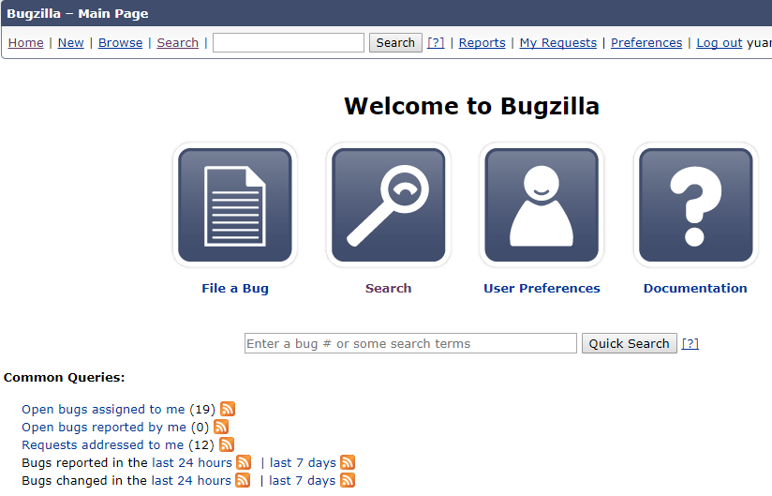

Trend 3.0 Architecture
Data Visualization
Data Service Cluster
……
Data Center
Redis
MongoDB
HBase
Zookeeper
Data Pre-Processing/Shuffle
Kafka
Topic: uTrack
Topic: Bugzilla
Topic: Tracker
Data Collector
uTrack
Bugzilla
Tracker

Slide 11
Trend 4.0 Architecture
Data Visualization
Data Service Cluster
……
Data Center
Map Reduce
HBase
Hive
Sqoop
Spark SQL
Redis
MongoDB
YARN
Spark Stream
HDFS
Zookeeper
Data Pre-Processing/Shuffle
Kafka
Topic: uTrack
Topic: Bugzilla
Topic: Tracker
Data Collector
uTrack
Bugzilla
Tracker

Slide 12
Project Plan
Working Hours(4) 2 hours in Tu/Th

Slide 13
Thank You!

